Slide 1

BANGALORE INSTITUTE OF TECHNOLOGY
K.R Road, V.V Pura, Bengaluru-04
DEPARTMENT OF ARTIFICIAL INTELLIGENCE & MACHINE LEARNING
“REDNET”
Presented by
1BI23AI040 Prabhav Sharma
1BI23AI047 Rishabh Sharma
PID 31
V Semester
Under the Guidance of
Prof. Manoj Kumar H
Assistant Professor

Slide 2
Introduction
Background:
Child street vending is a serious issue in India, exposing children to exploitation and depriving them of education.
Manual monitoring by authorities and NGOs is inefficient and lacks real-time detection capability. With advancements in artificial intelligence and deep learning, automated surveillance is now possible. Models like HAREDNet can recognize human actions, while Wide ResNet can estimate age from facial features.
This helps in generating timely alerts for intervention and rescue. The project aims to support efforts toward eradicating child labor through AI-based monitoring.

Slide 3
Project Overview
The project is an AI-driven system that analyzes CCTV footage to detect children selling goods at traffic signals, maps frequent locations as hotspots, and automatically alerts nearby NGOs. It enables real-time monitoring, timely intervention, and data-driven decision-making to protect vulnerable children while ensuring privacy and ethical compliance.
The platform automatically generates real-time alerts to nearby NGOs, social workers, or child protection agencies, enabling timely intervention and support. By combining AI-driven detection with geographic mapping and automated communication, the system ensures that vulnerable children receive assistance before they are exposed to further harm.

Slide 4
Purpose of study
To identify and monitor areas where children are frequently engaged in street vending.
To provide NGOs with timely, actionable information for intervention.
To reduce the risk of accidents and exploitation for street children.
To explore AI and computer vision applications in social impact projects.

Slide 5
Literature Survey
SL. NO | TITLE | AUTHOR | YEAR OF PUBLICATION | ADOPTED METHOD | LIMITATIONS
1. | HAREDNet: A deep learning based architecture for autonomous video surveillance by recognizing human actions | Inzamam Mashood Nasir, , Mudassar Raza, Jamal Hussain Shah, Shui-Hua Wang, Usman Tariq, Muhammad Attique Khan | 2022, Elsevier, Research Paper | Proposed a hybrid deep learning model combining an Encoder-Decoder CNN-RNN (EDNet) with local features (iSIFT, iGabor, LOMO) and CvQDA-based fusion for robust action recognition. | Accuracy decreases in complex real-world scenes with multiple subjects or limited labeled data, requiring high preprocessing quality.
2. | Age Detection in a Surveillance Video Using Deep Learning Technique | S. Vasavi1, P. Vineela1, S. Venkat Raman | 2021, Science Direct, Research Paper | A modified Wide ResNet architecture with data augmentation and reconstruction techniques is used to accurately predict age from surveillance video images, learning facial features for 101-class classification. | Detection accuracy drops in cluttered backgrounds and with occluded faces, as the model struggles with overlapping or partially visible objects.
3. | Object Detection using CNN & Transformer Models | Shrishti Shah, Jitendra Tembhurne | 2023, Springer, Review Paper | Conducted a comprehensive comparison of CNN and transformer-based object detection architectures using benchmark datasets to analyze their efficiency and accuracy. | Transformer models are computationally expensive and struggle with small object detection, while CNNs lack global spatial understanding.

Slide 6
4. | Comparative analysis of deep learning image detection algorithms | Shrey Srivastava, Amit Vishvas Divekar, Chandu Anilkumar, Ishika Naik, Ved Kulkarni and V. Pattabiraman | 2021, Springer, Research Paper | The paper performs a comparative analysis of SSD, Faster R-CNN, and YOLOv3 using the Microsoft COCO dataset, evaluating accuracy, speed, and efficiency to identify their strengths for different use cases. | SSD struggles with small object detection accuracy, Faster R-CNN is slower due to complex region proposals, and YOLOv3 has complexity and accuracy limitations especially with smaller objects despite being the fastest.
5. | Violence Detection Approach based on Cloud Data and Neutrosophic Cognitive Maps | Mohammad Saif Wajid1, Hugo Terashima‑Marin, Peyman Najafirad Paul Rad and Mohd Anas Wajid | 2022, Springer, Research Paper | Neutrosophic Cognitive Maps to model and analyze violence by incorporating both determinate & indeterminate factors derived from cloud data, expert opinions, and literature, enabling better handling of uncertainty compared to traditional fuzzy methods. | Limited set of factors and does not address other indeterminacies like noise and redundant data in video-based violence detection; future work could expand factor sets and integrate knowledge graphs for improved modeling.
6. | LGC-YOLO: Local-Global Feature Extraction and Coordination | Qinggang Wu , Yang Li, Junru Yin, and Xiaotian You | 2022, Springer, Research Paper | LGC-YOLO is a single-stage remote sensing object detection network with modules enhancing local-global feature extraction, noise suppression, and edge-detail preservation for accurate detection of small, dense objects. | Faces challenges in highly complex scenes with occlusions and background interference, requiring further improvement.

Slide 7
7 | A comprehensive survey on RGB‑D‑based human action recognition: algorithms, datasets, and popular applications | Yumin Zhang and Yanyong Wang | 2025, Springer, Review Paper | Uses Neutrosophic Cognitive Maps to model violence by incorporating both known and uncertain factors from cloud data and expert opinions, improving handling of data uncertainty in violence detection. | The model currently covers limited factors and does not fully address noisy or incomplete data in real-time video detection, leaving room for future improvement.
8 | Object detection in real time based on improved single shot multi-box detector algorithm | Ashwani Kumar, Zuopeng Justin Zhang and Hongbo Lyu | 2020, Spring, Research Paper | The paper improves the SSD algorithm by using depth-wise separable and spatial separable convolutions to enhance small object detection accuracy while maintaining real-time speed, evaluated on Pascal VOC and COCO datasets. | The model struggles with blockage, deformable, corrupt, and interlaced objects and cannot detect new unseen object classes without retraining.
9 | You Only Look Once: Unified, Real-Time Object Detection | Joseph Redmon, Santosh Divvala, Ross Girshick , Ali Farhadi | 2025, IEEE, Research Article | YOLO frames object detection as a unified regression problem that directly predicts bounding boxes and class probabilities from full images in one evaluation, enabling real-time, end-to-end detection with a single neural network. | YOLO struggles with detecting small objects, spatially close groups of objects, and generalizing to unusual aspect ratios due to its grid-based prediction constraints and relatively coarse feature maps.

Slide 8
10 | Gender-based Detection and Tracking of Child Pedestrians using Machine Learning | Tyler Ward | 2024, IEEE, Research Paper | Pedestrian detection and tracking framework for autonomous vehicles using the YOLOv8 object detection model combined with ByteTrack for multiple object tracking, enabling gender-based classification of child pedestrians and differentiation from adults. | ystem shows slightly lower accuracy for girls due to dataset imbalance and is limited by the extent of preprocessing, requiring further improvements for speed estimation and predictive modeling based on pedestrian behavior.
11 | Parallel Convolutional Neural Networks for Object Detection | Adedeji Olugboja and Zenghui Wang | 2022, IEEE, Research Paper | CNN architecture with multiple parallel CNNs having the same or different numbers of convolutional layers, whose outputs are combined and passed to a fully connected back-propagation neural network | The study is limited to benchmark datasets like CIFAR-10, CIFAR-100, and MNIST, and future work is needed to explore fine-tuning, batch normalization, and data augmentation for better performance on more complex real-world data.
12 | Deep Learning for Human Action Recognition: A Comprehensive Review | Duc-Quang Vu1, Trang Phung Thi Thu, Ngan Le and Jia-Ching Wang | 2023, IEEE, Review Paper | Categorizes deep learning techniques for human action recognition into supervised, semi-supervised, and self-supervised learning, highlighting architectures like 3D CNNs, RNNs, and Transformers. | High computational costs, lack of long-range temporal information, dependency on large labeled datasets, and difficulty in real-world scenarios with occlusion and multi-person interactions.

Slide 9
13 | Exploring Deep Learning-Based Architecture, Strategies, Applications and Current Trends in Generic Object Detection: A Comprehensive Review | LUBNA AZIZ, MD. SAH BIN HAJI SALAM, USMAN ULLAH SHEIKH , AND SARA AYUB | 2020, IEEE, Review Paper | Deep learning object detection methods include two-stage detectors (e.g., R-CNN family) and one-stage detectors (e.g., YOLO, SSD) balancing accuracy and speed. | Two-stage detectors face high computational cost; one-stage detectors struggle with small, overlapping, or irregular objects detection.
14. | Enhancing Object Detection in Dense Images: Adjustable Non-Maximum Suppression for Single-Class Detection | KYEONGMI NOH, SEUL KI HONG, STEPHEN MAKONIN AND YONGKEUN LEE | 2024, IEEE, Research Article | Proposes an adjustable NMS algorithm that dynamically calculates IoU and confidence score thresholds in real-time to improve detection accuracy in densely packed images. | Additional computational overhead from real-time threshold calculation and currently limited to single-class detection; extending to multi-class scenarios requires further research.
15. | Design of an Integrated Model for Video Summarization Using Multimodal Fusion and YOLO for Crime Scene Analysis | SAI BABU VEESAM AND ARAVAPALLI RAMA SATISH | 2024, IEEE, Research Article | Combining YOLOv8 with Feature Pyramid Networks, Attention-Guided Multimodal Fusion Network, 3D CNNs with Temporal Attention, and Reinforcement Learning with Human-in-the-Loop to enable real-time multi-camera crime | High computational resources and may face challenges in extreme lighting, occlusion, and dynamic environments, necessitating further research on adaptive learning
16 | Bringing Intelligence to SAR Missions: A Comprehensive Dataset and Evaluation of YOLO for Human Detection in TIR Images | MOSTAFA RIZK, AND ISRAA BAYAD | 2024, IEEE, Research Article | Diverse thermal image dataset with accurate human annotations and evaluated multiple YOLOv8 variants and YOLOv7-Tiny for human detection, showcasing high precision and fast inference rates | Challenges remain in further optimizing models for deployment on low-power embedded edge devices to enable real-time detection in resource-constrained field environments.

Slide 10
17 | An Efficient Scheme to Obtain Background Image in Video for YOLO-based Static Object Recognition | Hyeong-Jin Kim, Min-Cheol Shin, Man-Wook Han, Chung-pyo Hong and Ho-Woong Lee | 2022, IEEE, Research Paper | Proposes a pixel-level histogram-based algorithm with frame overlap to estimate background in videos, enhancing static object recognition by applying YOLO v3 on the estimated background. | The method's performance deteriorates with camera movement or rapid lighting changes, making accurate background estimation challenging in such dynamic conditions.
18 | An Efficient Detection of Suspicious Objects from Dynamic Video Surveillance by Fusion-based Multiview Deep Learning Techniques | Ramesh Chandra Poonia, Kamal Upreti, Nidhi Singh, Jyoti Kesarwani and Mohammad Shabbir Alam | 2024, IEEE, Research Paper | Fusion-based multiview deep learning approach combining YOLOv8 nano and YOLOv8 large models through weight and feature-level fusion to enhance detection accuracy and speed of suspicious objects in dynamic video surveillance. | Scalability challenges with massive video datasets, requiring advanced sampling algorithms to handle large-scale, diverse, and complex dynamic video data effectively.
19 | OneN: Guided attention for natively-explainable anomaly detection | Pasquale Coscia, Angelo Genovese , Vincenzo Piuri , Fabio Scotti | 2025, Elsevier, Research Paper | Proposes OneN, a unified attention-based architecture using knowledge distillation from CNN to Vision Transformer that integrates anomaly detection, localization, and classification in a single model with a progressive masking focal loss for improved defect localization. | Challenges include handling subtle anomalies in complex backgrounds, addressing class imbalances, and optimizing deployment efficiency for resource-constrained industrial settings.
20 | PP-YOLO: An Effective and Efficient Implementation of Object Detector | Xiang Long, Kaipeng Deng, Guanzhong Wang, Yang Zhang, Qingqing Dang, Yuan Gao, Hui Shen | 2022, Science Direct, Research Paper | PP-YOLO improves YOLOv3 by integrating various existing "tricks" such as a ResNet50-vd-dcn backbone, Exponential Moving Average, DropBlock, IoU Loss, Matrix NMS, CoordConv, and Spatial Pyramid Pooling | While improving accuracy and speed, it does not explore novel backbone architectures or data augmentation, and further gains could be achieved by using advanced pretraining

Slide 11
Drawbacks of Existing System
Delayed Intervention: Manual reporting or helplines often reach NGOs too late, leaving children exposed to danger.
No Real-Time Protection: Children continue to face accidents, harassment, or abuse at traffic signals.
Exploitation Risk: Without monitoring, traffickers or exploiters can take advantage of vulnerable children.
Health Hazards: Long hours in traffic expose children to pollution, injuries, and fatigue.
Lack of Awareness: Authorities and NGOs may not know high-risk locations or frequency of child vending.

Slide 12
Problem Statement
“In India, a significant number of children are forced into street vending at traffic signals, exposing them to traffic accidents, harassment, exploitation, and unsafe working conditions. Current mechanisms rely primarily on manual reporting or helplines, which are often slow, lack real-time monitoring, and fail to provide actionable, data-driven insights. As a result, these vulnerable children frequently go without timely protection or intervention, highlighting the urgent need for an automated, intelligent system to ensure their safety and well-being”

Slide 13
Proposed System
The proposed system is an AI-driven solution that leverages CCTV footage to detect children engaged in street vending at traffic signals in real time. It identifies recurring locations as hotspots, monitors the number of children present in each area, and automatically notifies nearby NGOs to enable timely intervention, protection, and support. By combining real-time monitoring with data-driven insights, the system facilitates proactive child welfare measures while maintaining strict ethical standards and safeguarding privacy.

Slide 14
Input:
Real-time video feeds or CCTV footage from public areas and marketplaces.
Each frame extracted from the video acts as input to the deep learning model.
The system uses object detection and human action recognition techniques (based on HAREDNet architecture) to identify human subjects and their actions.
The facial region of detected children is further analyzed using age estimation models (based on modified Wide ResNet) to determine if the person is a child (below 18 years).

Slide 15
Output:
Identification and classification of individuals in the video as child or adult.
Detection of vending actions (e.g., selling goods, interacting with customers, handling items).
Alert generation for suspected cases of child street vending with timestamp and location metadata.
Optional dashboard showing:
Total number of detected children,
Identified child vendors,
Real-time alerts and logs for authorities or NGOs.

Slide 16
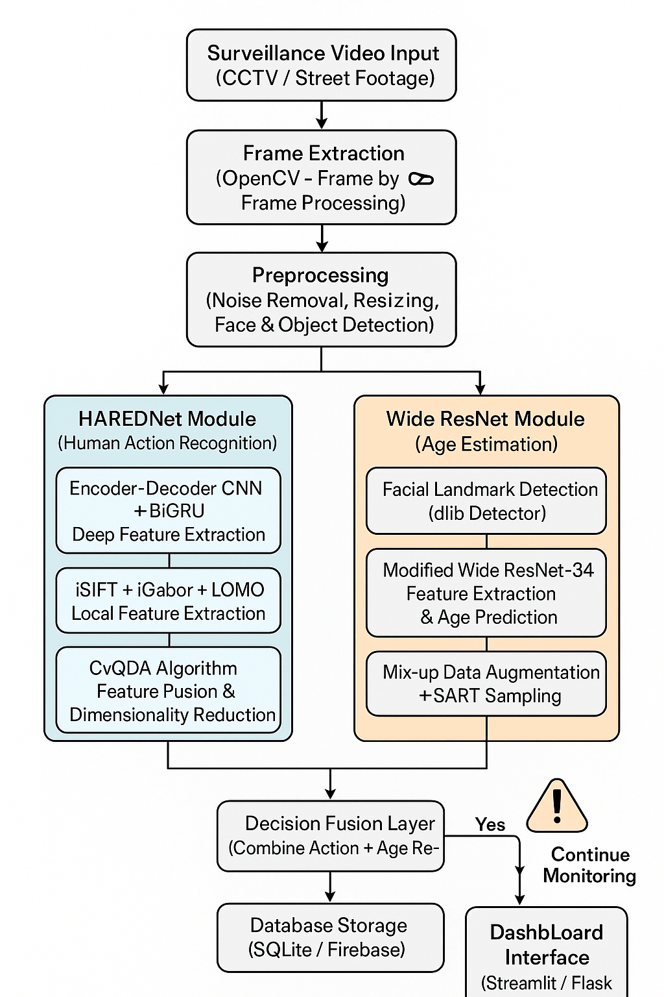
Architecture
Input & Preprocessing:
Surveillance video is captured and converted into frames using OpenCV, followed by preprocessing.
Dual Deep Learning Models:
HAREDNet & Wide ResNET for identifting human actions & their age
Decision Fusion Layer:
Combines action recognition and age prediction results to determine if the detected individual is a child engaged in vending activity.
Output & Monitoring:
Generates real-time alerts, store results in database.

Slide 17
Objectives
Detect children vs adults with ≥88% precision and ≥85% recall on a pilot dataset.
Achieve age MAE ≤ 2.5 years for detected faces
Classify vending/selling behavior with ≥85% accuracy on curated tracklets.
Maintain false alarm rate ≤ 10% per camera per week.
Generate hotspot maps updated hourly and report top 10 hotspots per month.
Achieve an NGO response rate of ≥75%, meaning at least 75% of human-verified alerts result in an on-ground NGO intervention within 24 hours during the 3-month pilot.
Ensure ethical AI compliance by anonymizing detected individuals and adhering to privacy and data protection standards.

Slide 18
Tools and Technologies
Programming Language: Python
Frameworks & Libraries: TensorFlow / PyTorch, OpenCV, NumPy, Pandas, Matplotlib
Deep Learning Models:
HAREDNet (Hybrid Encoder–Decoder Network) for human action recognition
Wide ResNet for facial age estimation
Supporting Tools:
dlib for facial landmark detection
Jupyter Notebook / Google Colab for development
SQLite or Firebase for alert data storage

Slide 19
Data Collection and Analysis Methods
Data Collection:
Use publicly available surveillance datasets (e.g., NTU RGB+D, UCF-101 for action recognition, APPA-REAL for age detection).
Collect short real-world video clips from public markets or streets (with consent or from open-source datasets).
Preprocessing:
Frame extraction, resizing, and noise reduction using OpenCV.
Face detection and cropping for age estimation.
Annotation of frames (child vs adult, vending action vs normal).

Slide 20
Model Training and Analysis:
Train and fine-tune the models (HAREDNet + Wide ResNet) for combined action + age classification.
Evaluate using metrics like accuracy, precision, recall, F1-score, and mean absolute error (for age prediction)
Output Analysis:
Analyze the frequency and location of detected child vendors.
Visualize detection results and alerts on a simple dashboard or console log.
<number>

Slide 21
Requirement Engineering
Software Requirements:
Programming Language: Python 3.x
Frameworks & Libraries: TensorFlow / PyTorch, OpenCV, dlib, NumPy, Pandas
Development Environment: Jupyter Notebook or Google Colab
Database & Visualization: SQLite / Firebase for storage, Streamlit or Flask for dashboard
Operating System: Windows 10 / Ubuntu Linux
Hardware Requirements:
Camera / Video Source: CCTV or HD webcam for real-time surveillance input

Slide 22
Software Requirements Specification
Functional Requirements:
The system shall capture or process live CCTV/video footage from public areas or marketplaces.
The system shall identify the age group (child or adult) using facial analysis.
The system shall recognize specific actions such as vending, selling, or handling goods.
The system shall generate real-time alerts when a child is detected performing vending activities.
The system shall store detection data (image/frame, timestamp, location, classification result) in a database.

Slide 23
Software Requirements Specification
Non-Functional Requirements:
Performance: The model should process frames in near real-time.
Accuracy: Achieve at least 85–90% accuracy in both child identification and action recognition.
Scalability: The system should be capable of handling multiple camera feeds simultaneously.
Security: Data and video footage must be stored securely and accessible only to authorized personnel.
Usability: The dashboard interface should be simple, intuitive, and easy to operate.

Slide 24
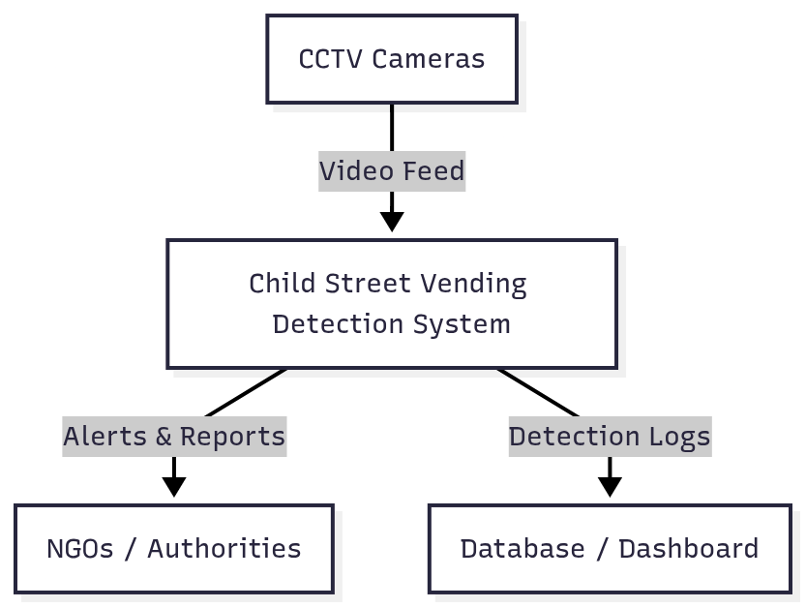
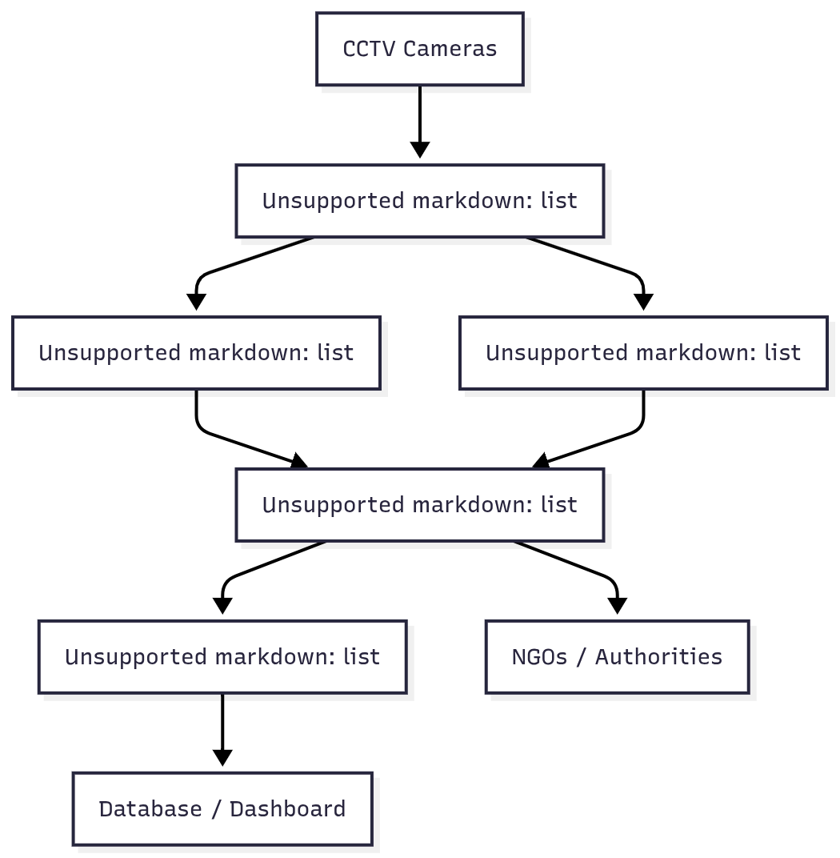
Hierarchical Data Flow Diagram
Level 0 DFD (Context Diagram)
Level 1 DFD (System Overview)

Slide 25
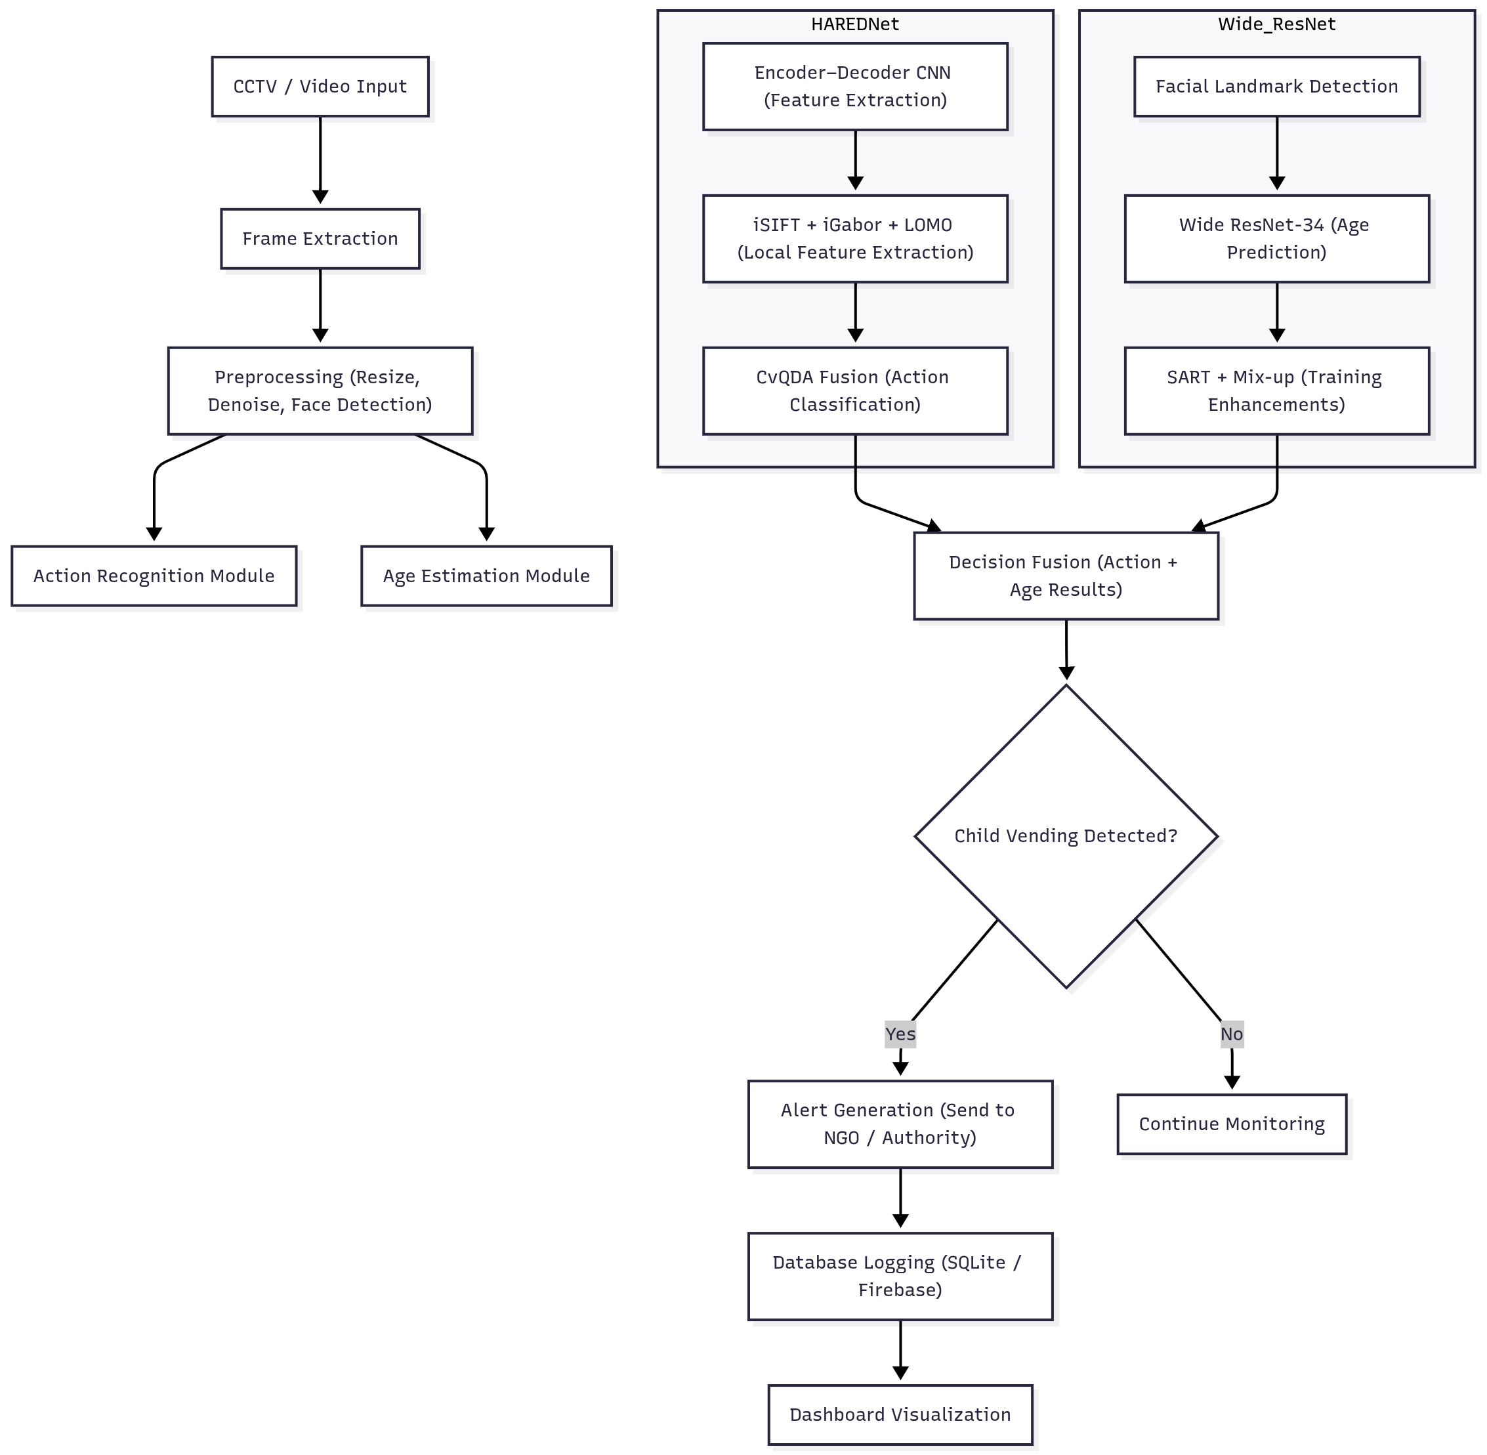
Level 2 DFD (Detailed Process Flow)
<number>

Slide 26
Applications
Real-time Surveillance: Automated detection of child vendors in live CCTV feeds for quick intervention by authorities.
NGO and Government Support: Helps social welfare departments and NGOs monitor and identify areas with high child labor activity.
Law Enforcement Evidence: Provides visual and timestamped proof to support legal and rescue operations against child exploitation.
Data Analytics for Policy Making: Aggregated data helps policymakers identify child labor hotspots and design targeted welfare programs.
Smart City Integration: Can be integrated into existing smart surveillance networks for urban safety and social monitoring.
Public Awareness and Reporting: The system’s analytics can be used to inform citizens and organizations about child labor zones.

Slide 27
References
Aly S, Sayed A. Human action recognition using bag of global and local Zernike moment features. Multimedia Tools and Applications, 2019; 78:24923–953.
Du Y, Wang W, Wang L. Hierarchical recurrent neural network for skeleton-based action recognition. Proc. CVPR, 2015.
Gammulle H, Denman S, Sridharan S, Fookes C. Two stream LSTM: a deep fusion framework for human action recognition. IEEE WACV, 2017.
Vishwakarma DK. A two-fold transformation model for human action recognition using decisive pose. Cognitive Systems Research, 2020; 61:1–13.
Gao Z, Xuan H-Z, Zhang H, Wan S, Choo K-KR. Adaptive fusion and category-level dictionary learning model for multiview human action recognition. IEEE IoT Journal, 2020; 6:9280–93.
Chaudhary S, Murala S. Deep network for human action recognition using Weber motion. Neurocomputing, 2019; 367:207–216.

Slide 28
Levi G, Hassner T. Age and gender classification using convolutional neural networks. IEEE Workshop on Analysis and Modeling of Faces and Gestures, 2015.
Agbo-Ajala O, Viriri S. Face-based age and gender classification using deep learning model. Lecture Notes in Computer Science, vol. 11994, Springer, 2019.
Zhang H, Cisse M, Dauphin YN, Lopez-Paz D. Mixup: Beyond empirical risk minimization. arXiv:1710.09412, 2017.
Bobrov E, Georgievskaya A, Zhavoronkov A, et al. PhotoAgeClock: Deep learning algorithms for non-invasive visual biomarkers of aging. Aging, 2018; 10(11):3249–59.
Rondeau J, Alvarez M. Deep modeling of human age guesses for apparent age estimation. International Joint Conference on Neural Networks (IJCNN), 2018.
Xu J. A deep learning approach to building an intelligent video surveillance system. Multimedia Tools and Applications, 2021; 80:5495–515.
Lowe DG. Distinctive image features from scale-invariant keypoints. International Journal of Computer Vision, 2004; 60:91–110.

